Slide 1
Grid-tie, off-grid solar and backup power solutions
For residential and commercial installations
Alexandru Cojocaru
19 November 2013

Slide 2
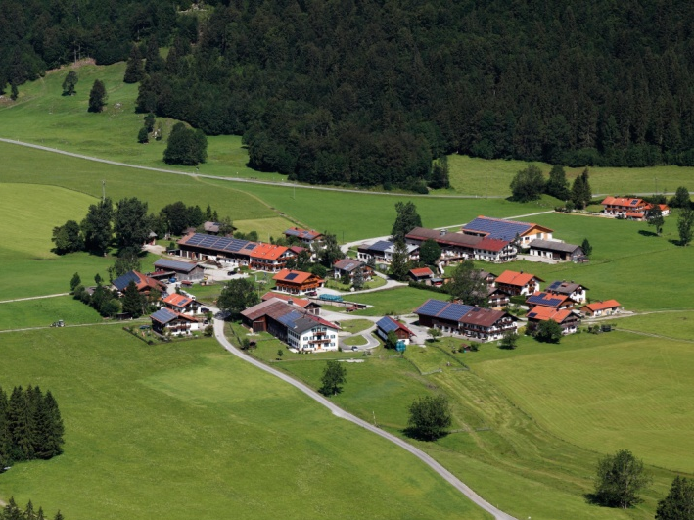
Smarter investment in photovoltaic solutions for
all grid-tie, off-grid solar and backup installations
When it comes to grid-tie and off-grid and backup residential and commercial installations, Schneider Electric has both the experience and the proven technology to help make your investment a success.
Schneider Electric solutions for residential and commercial installations are specially designed by keeping your needs in mind. Our balance-of-system solutions include everything you need to efficiently distribute and manage locally generated solar energy, from the DC output to the AC grid connection.
Partnering with Schneider Electric gives you a higher return on investment and peace of mind
Schneider Electric is ranked among Top 3 Most Competitive Inverter Companies in the world according to GTM Research
^{Broad}
^{Portfolio}
for your grid-ties and off-grid installations
^{Best}
^{in class}
^{products}
^{Global}
^{support}
^{presence in 100+}
^{countries}
^{Superior}
^{technical}
^{service}

Slide 3
Why choose Schneider Electric’s solar products and solutions?
True bankability
Higher return
on investment
Designed for
reliability
Flexible
Easy to service
Easy to install

Slide 4
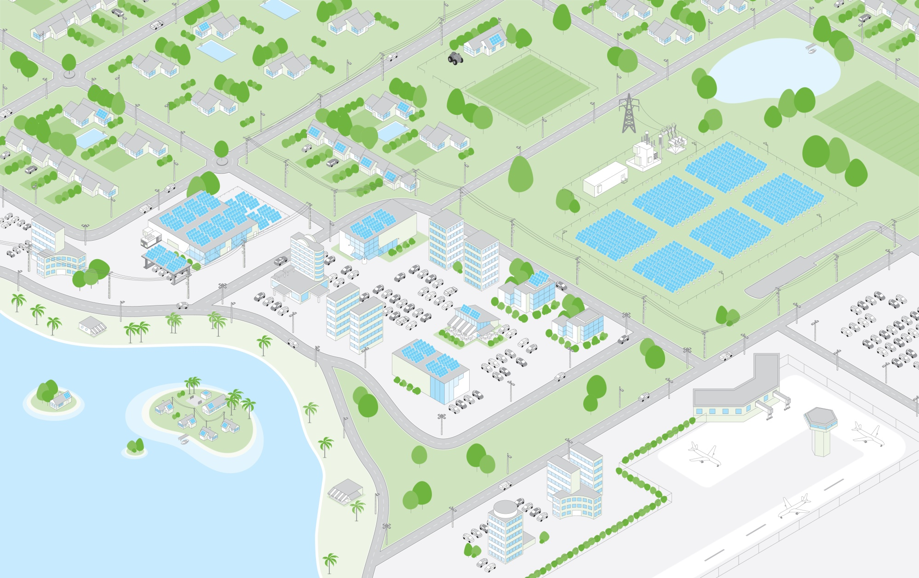
Solutions to cover all customer needs
8
Commercial off-grid solar
Residential backup power
5
1
Residential buildings
6
Residential grid-interactive solar with battery backup
2
Commercial buildings
and carports
3
Decentralised PV plants
4
Residential off-grid solar
Commercial grid-interactive solar with battery backup
9
Remote community electrification
7
Grid-tie residential and commercial building solutions
Off-grid solar and backup power solutions

Slide 5
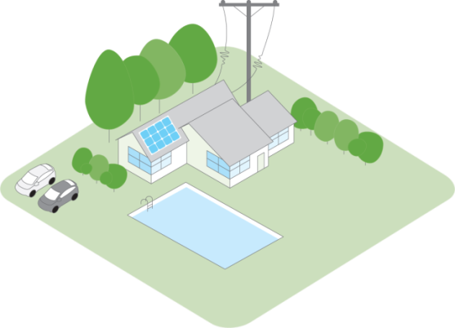
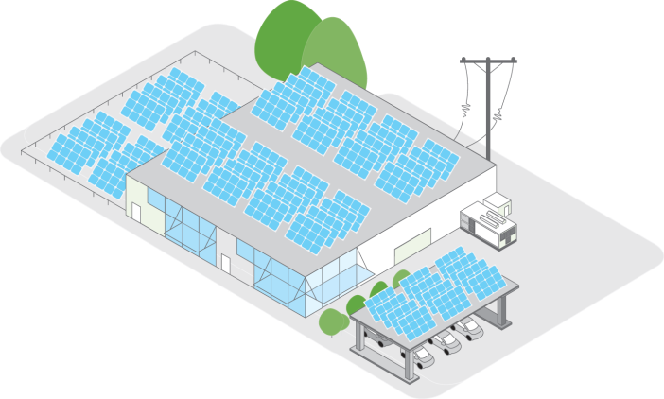
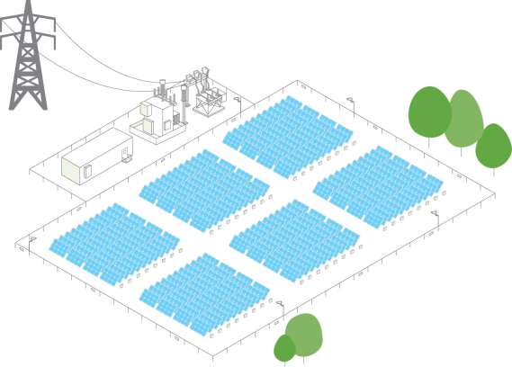
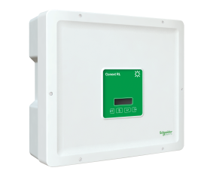
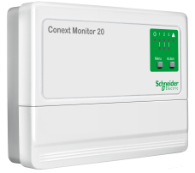
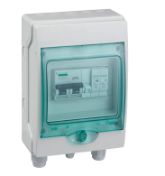
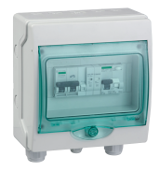
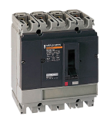
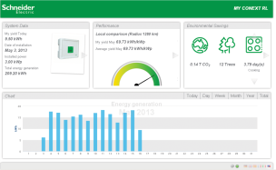
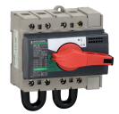
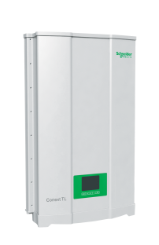
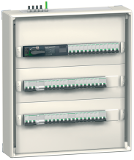
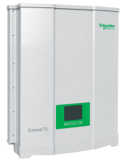
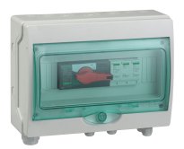
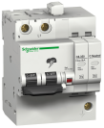
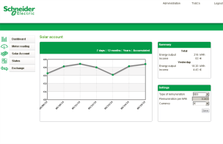
Unique portfolio of grid-tie, off-grid solar
and backup power products
Residential buildings
Commercial buildings and carports
Decentralised PV plants
1-phase grid-tie inverter
Monitoring
Accessories
Conext RL
(3, 4, 5 kW)
Conext
Monitor 20
PV emergency box
DC box
Small 3-phase transformerless grid-tie inverters
Conext TL
(8, 10 kW)
Conext TL
(15, 20 kW)
AC box
AC distribution
box
Circuit protectors and switches

Slide 6
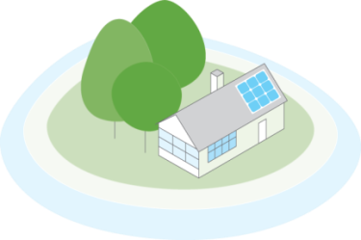
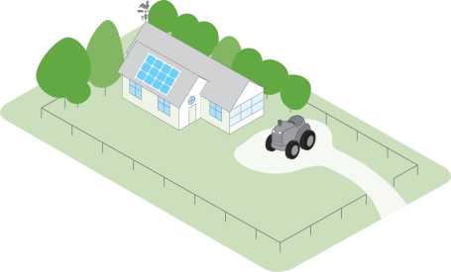
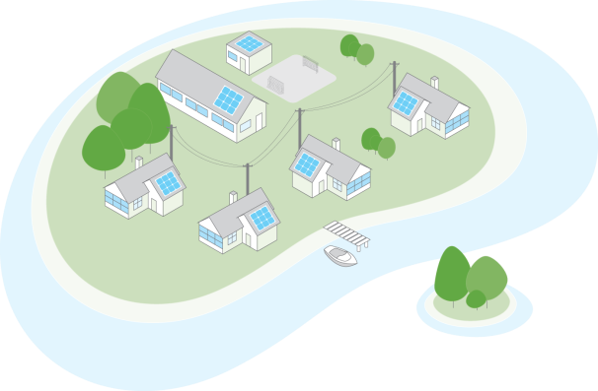
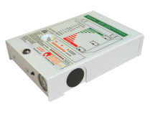
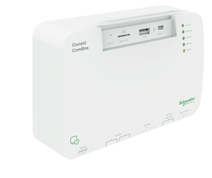
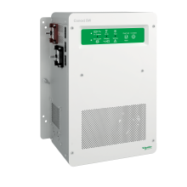
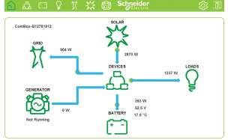
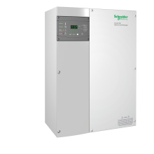
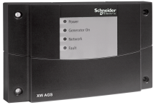
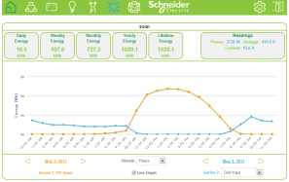
Unique portfolio of grid-tie, off-grid solar
and backup power products
Residential off-grid solar and backup power
Commercial off-grid solar and backup power
Remote community
electrification
Inverters/chargers and
charge controllers
Monitoring
Accessories
Conext
ComBox
C12 / C60
Universal DC
breaker panel
AC breaker panel
(120/240 V)
AC breaker panel (230 V)
Conext SW
(2.5, 4 kW)
MPPT
60 150
Conext XW
(4, 4.5, 6 kW)
MPPT
80 600
System Control
Panel (SCP)
Automatic Generator Start (AGS)
XW Power Distribution Panel
(PDP)

Slide 7
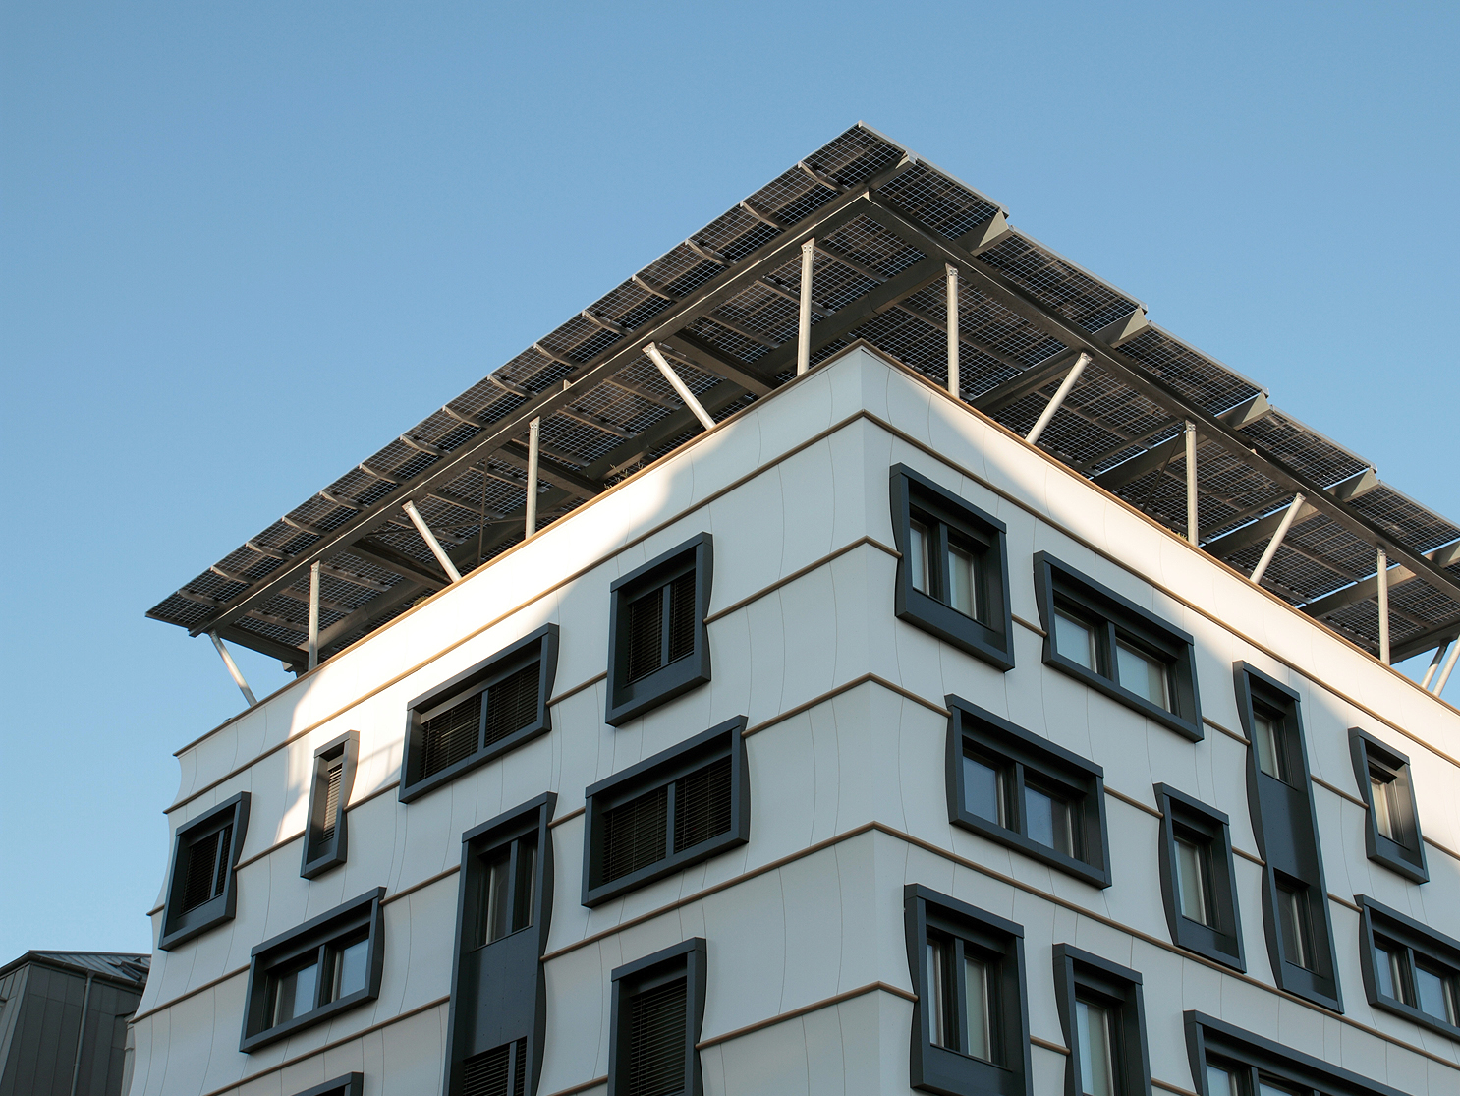
Grenoble, France
Commercial rooftop
50 kWp

Slide 8
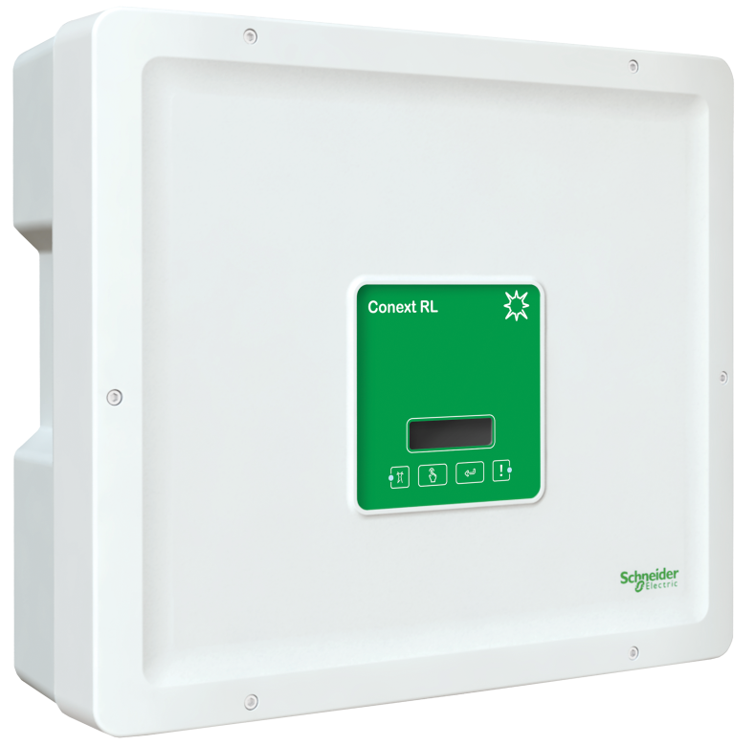
Conext RL single-phase grid-tie inverter
A flexible, efficient residential solar solution
Easy to both handle and install, the Conext RL inverters are specially designed to maximize yields for a wide range of rooftops of detached houses and multiple dwellings
Industry leading peak conversion efficiency of 97.5%
Rich MPPT features enable optimum installation for various roof types
Broad unit operating range extends your solar day
Shade-tolerant algorithm minimizes effect of shading
Reliable design, tested and qualified for harsh operating conditions

Slide 9
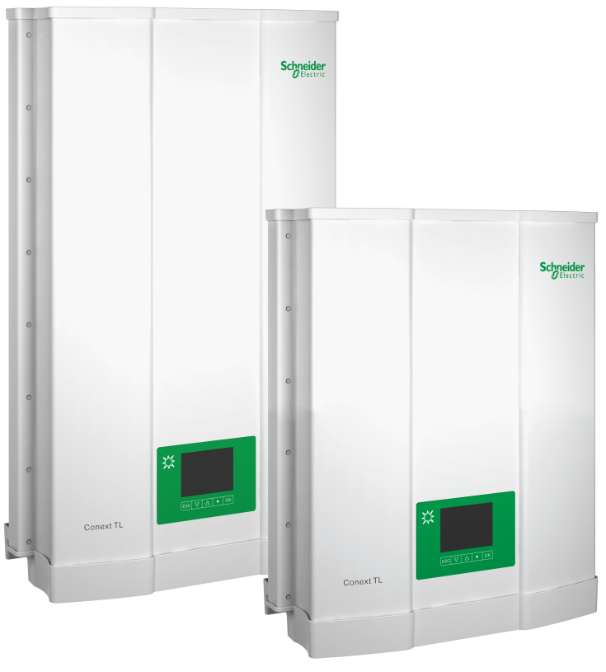
Conext TL three-phase grid-tie inverters
The ideal solution for commercial buildings, carports, and decentralised power plants. Available in 8, 10, 15 and 20 kW
The new Conext TL grid-tie solar inverters are suited for outdoor use and applications up to the MW range, providing dual maximum power point (MPP) trackers with a wide voltage range.
Modular system design using combination of models
Peak efficiency greater than 98%
Wide MPPT voltage range (350-850 V)
Easy to install and service
Reliable design, tested and qualified in harsher environmental conditions

Slide 10
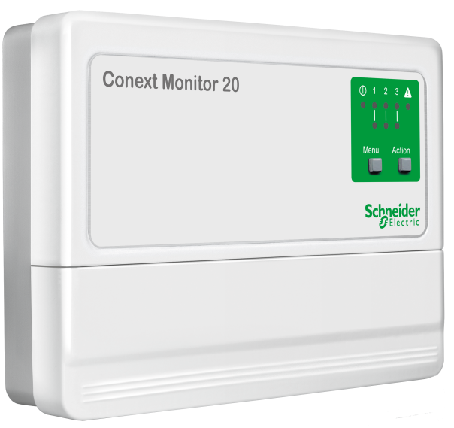
Conext Monitor 20 communication device
Compact and easy to use remote monitoring for residential PV installations
Conext Monitor 20 is a compact monitoring and control unit, that allows simple configuration and operation. Connecting the data logger to the internet via Ethernet allows the operating data to be visualized and monitored regardless of location using the web portal
Energy generation charts and regional benchmarking to proactively address PV plant performance issues, if any
Compatible with Conext RL and TL series of inverters
Access to PV plant performance regardless of location
Easy to install and service
Undergone extensive safety, quality and reliability testing

Slide 11
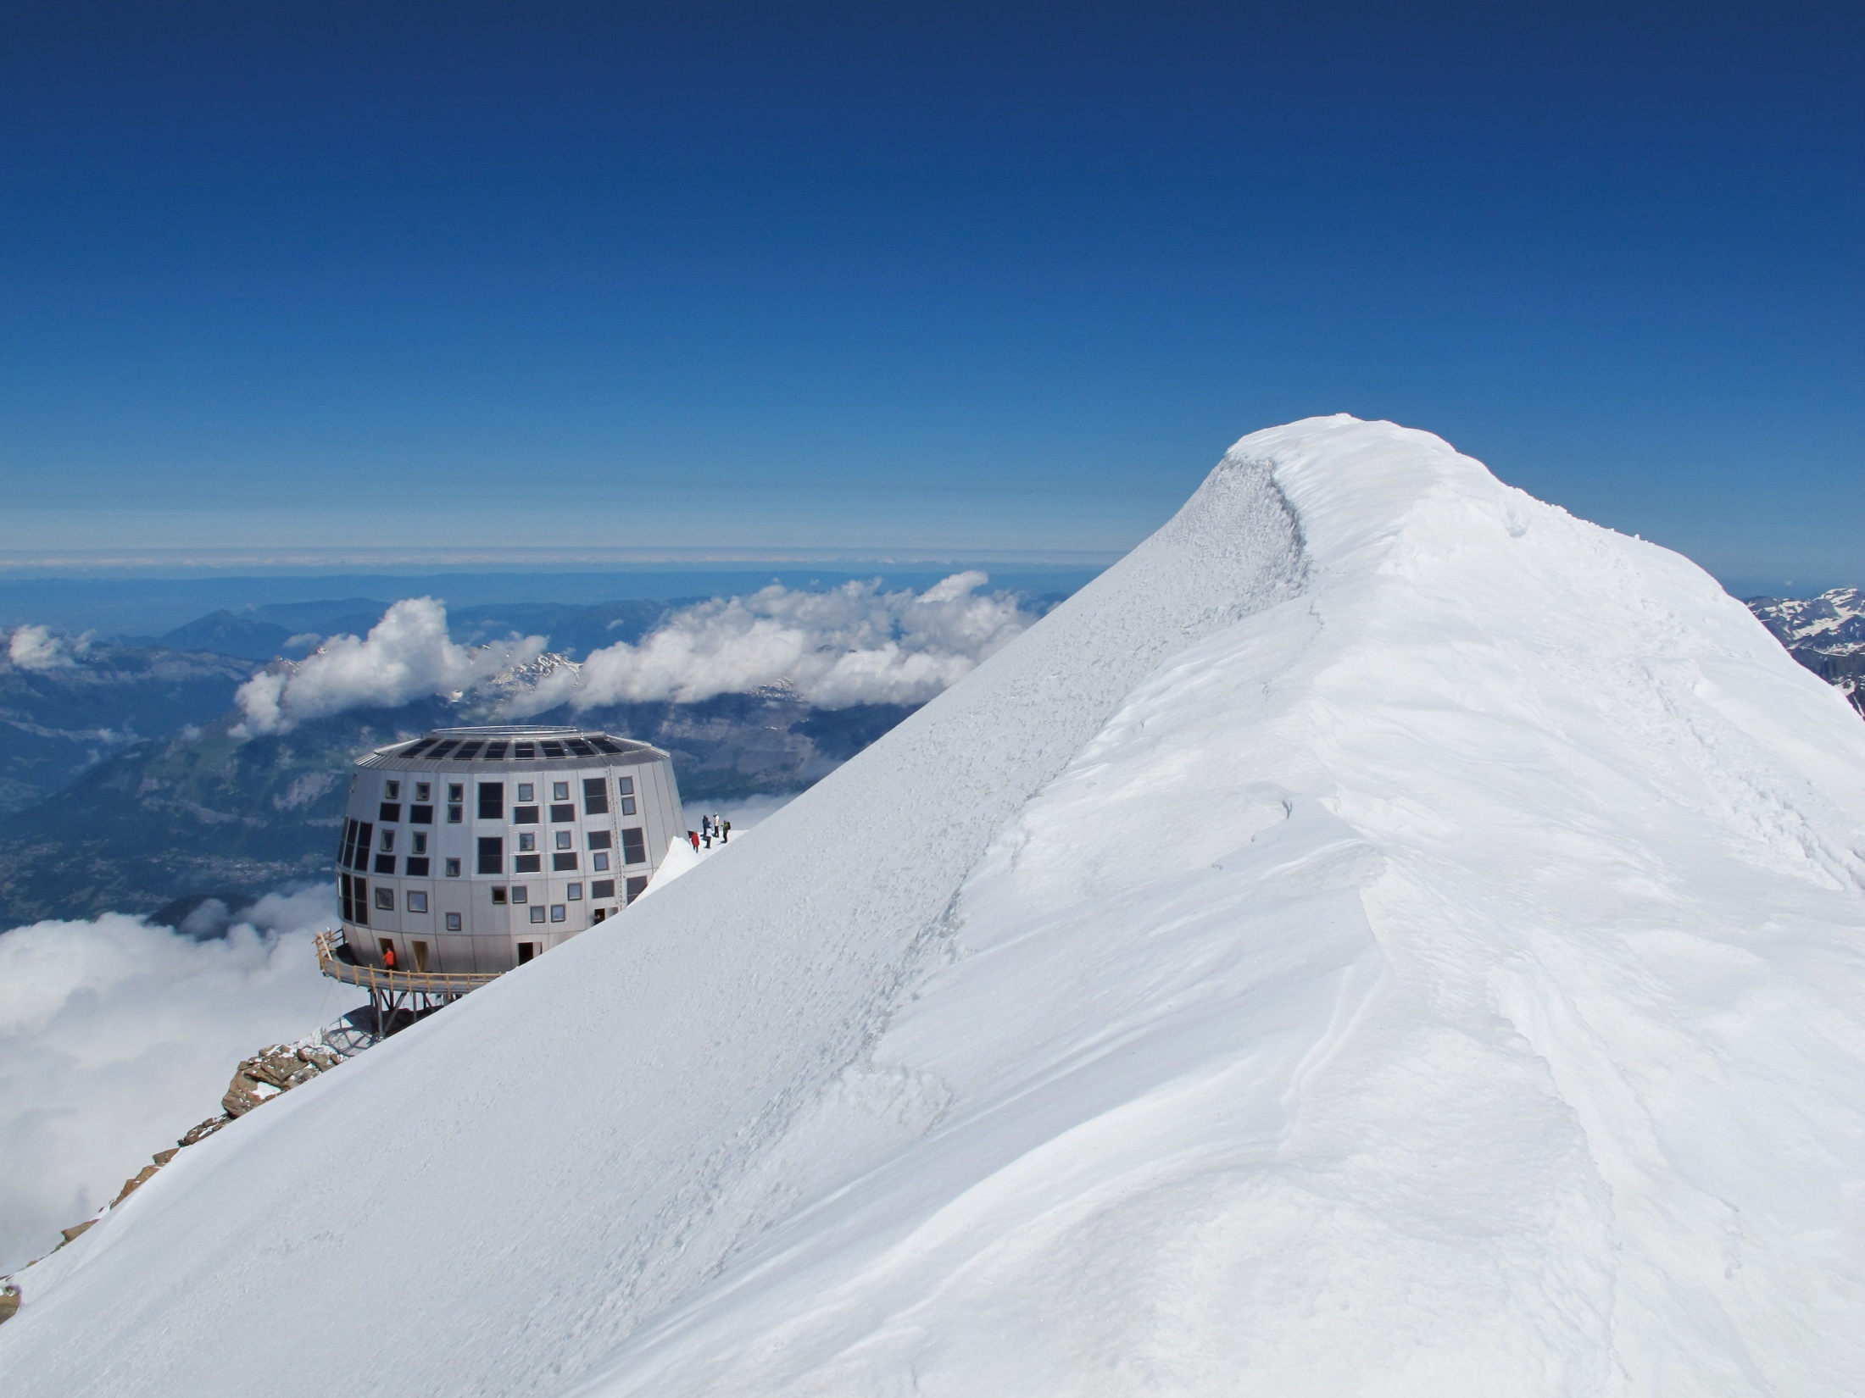
Refuge du Goûter, France
Off-grid solar
12 kWp

Slide 12
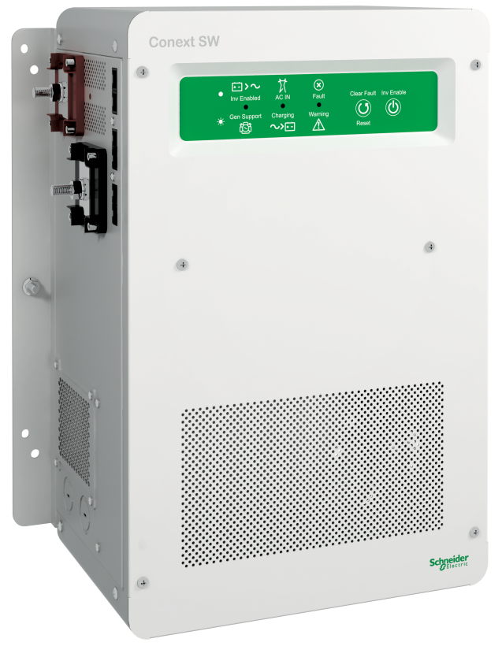
Conext SW inverter/charger
New value in off-grid solar and backup power
The Conext SW inverter/charger is a pure sine wave system with selectable 50/60 Hz functionality. Perfect for both residential and community projects, it provides additional value in the form of:
Warranty from a trusted partner with over 177 years of experience
Flexibility to support stackable power
Remote monitoring and configuration capabilities
Easy servicing with global support
Easy installation thanks to quick configuration

Slide 13
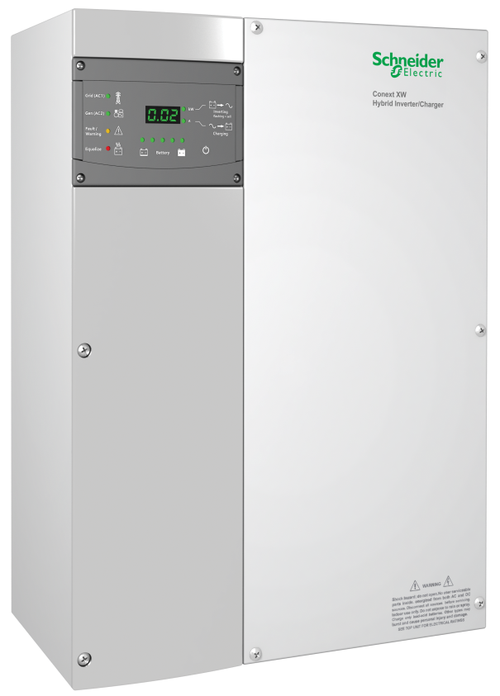
Conext XW inverter/charger (230 V / 50 Hz)
One solution for global power
The Conext XW inverter/charger is designed to provide long-term, reliable performance in grid-interactive and off-grid, residential and commercial, solar and backup power applications.
Scales from single units to multi-unit clusters of up to 36 kW
Easily integrates with a generator, reducing fuel costs
Easy to configure and service
Tested to ensure reliability and peace of mind
Global support

Slide 14
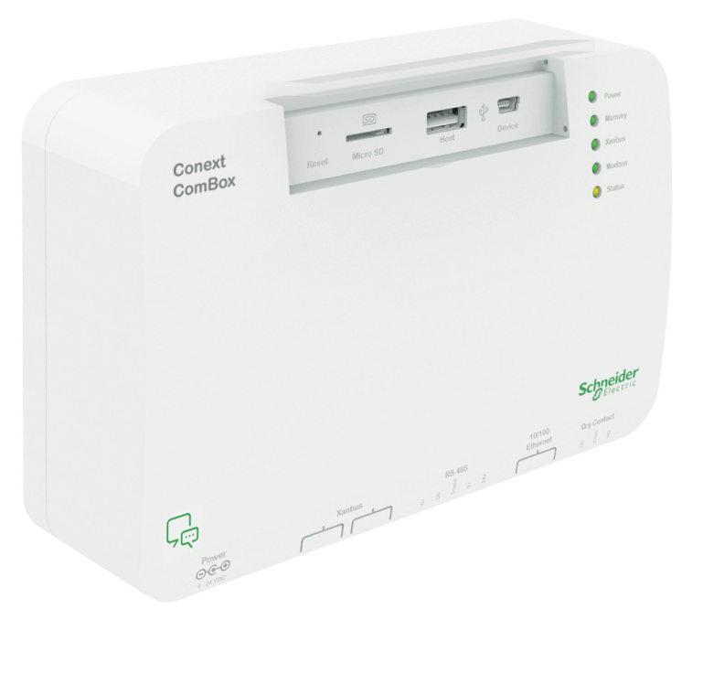
Conext ComBox communication device
New remote monitoring from Schneider Electric
Operators of Conext solar systems can now remotely monitor yield performance using devices of their choice, such as personal computers, tablet devices, or building management systems. Data logs and event logs for each device, as well as graphical displays of historical and solar system harvest, and plant yield are easily reviewed using a web browser or Android tablet device.
Monitor solar system harvest and yield
Configure up to twenty Xanbus protocol devices
Works with Conext XW, SW, TX, GT-AUS, MPPT 60-150, MPPT 80-600, AGS, SCP
Access Conext devices over Modbus protocol
Remotely monitor and faster access
Robust design through rigorous Multiple Environmental Over Stress testing (MEOST) and Temperature Humidity Bias (THB)

Slide 15
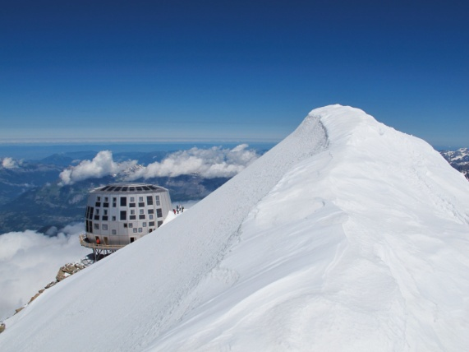
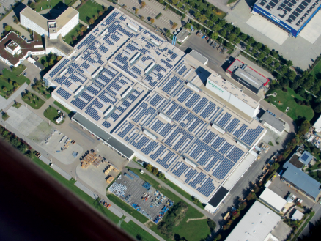
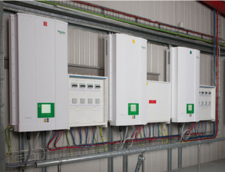
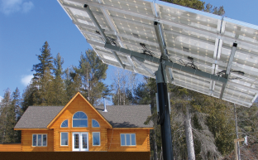
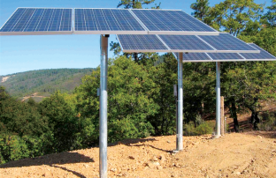
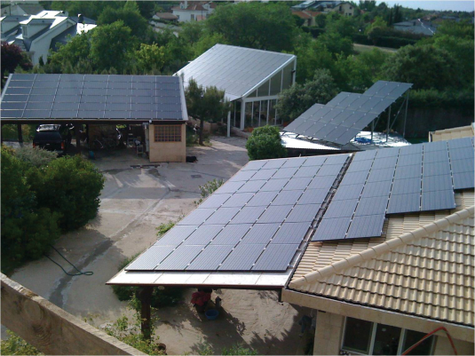
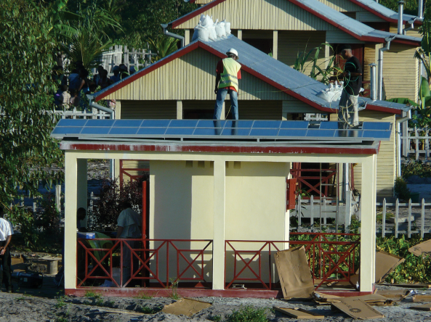
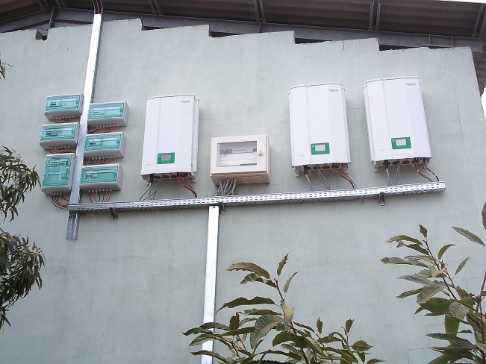
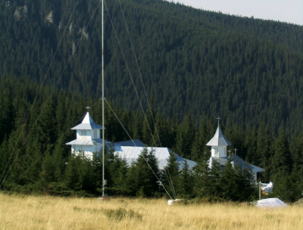
Selected customer references
Global support that makes
any size installation a success story
Refuge du Goûter
12 kWp
Ostwind, Germany
360 kWp
Monthey, Switzerland
95 kWp
Ontario, Canada
10 kWp
California, USA
4.5 kWp
Madrid, Spain
18 kWp
Marovato, Madagascar
1.5 kWp
Lunamatrona, Italy
145 kWp
Dorna, Romania
360 kWp

Slide 16
Thank you!
Make the most of your energySM
See our solutions on YouTube at www.youtube.com/schneidersolar

